Slide 1
“I used to have an open mind but my brains kept falling out.” -Steven Wright
“I was taught that the human brain was the crowning glory of evolution so far, but I think it's a very poor scheme for survival.” --Kurt Vonnegut, Jr.
Notes:
1

Slide 2
Announcements
Blackboard Quiz #3 due Sunday, Sept. 11, 11:59 pm.
It will cover the last 3 classes (through today’s class) on biomolecule and protein structure and identification.
Every person is in a group now, and we will begin some group activities soon.

Slide 3
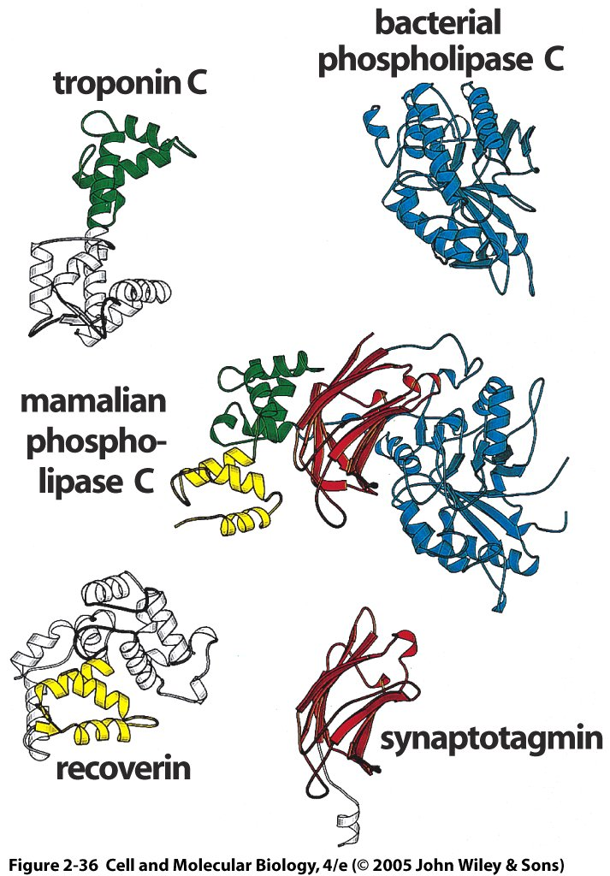
Larger proteins and more evolved proteins often consist of domains
Phospholipase C is involved in many intracellular signaling pathways triggered by activation of membrane receptors. Mammalian PLC consists of 4 domains:
Catalytic domain from bacterial PLC
Synaptotagmin (Ca2+ sensor)
Recoverin (Ca2+ triggered receptor)
Troponin C (binds Ca2+ to produce movement in muscle)

Slide 4
Problem 1: Get a pure protein sample to analyze
What characteristics can be used to identify proteins?
Size
Charge
Enzymatic Activity
Sequence
Secondary structure
Interactions with other proteins
Location in cell (membrane bound, mitochondrial, nuclear, etc.)
Appearance during development (embryonic, adult, dividing, etc.)
Notes:
Let’s see how far the class can get with hints here.

Slide 5
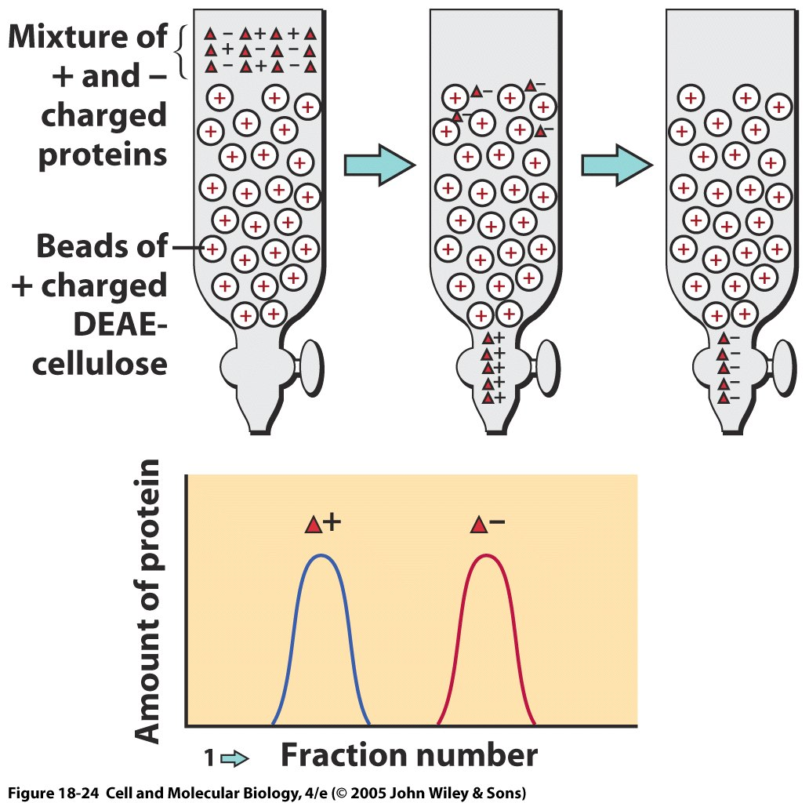
Chromatography
Mixture fractionated as it moves through a porous matrix
Mobile phase, protein in solvent
Immobile phase, protein caught in matrix
Fractions of solvent are captured at different time points
Proteins with least matrix affinity in first fraction, those with most in later fractions or captured in matrix
Notes:
This example shows ion-exchange chromatography

Slide 6
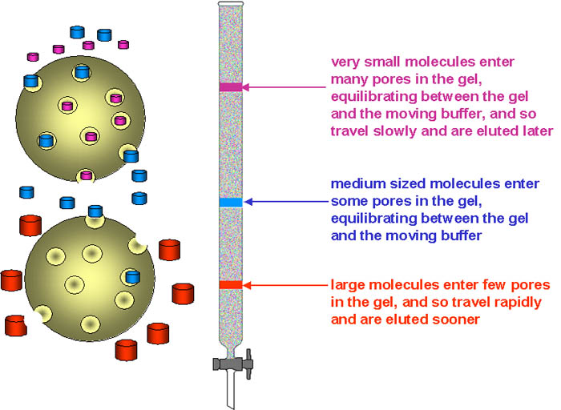
Gel exclusion chromatography (size filtration)
 | lower limit | upper limit
dextran gels
Sephadex G-50 | 1.5 | 30
Sephadex G-75 | 3 | 80
Sephadex G-100 | 4 | 150
Sephadex G-150 | 5 | 300
Sephadex G-200 | 5 | 600
polyacrylamide gels
Bio-Gel P-10 | 1.5 | 20
Bio-Gel P-30 | 2.5 | 40
Bio-Gel P-60 | 3 | 60
Bio-Gel P-100 | 5 | 100
Bio-Gel P-150 | 15 | 150
BioGel P-200 | 30 | 200
Bio-Gel P-300 | 60 | 400
dextran-polyacrylamide gels
Sephacryl S-200 | 5 | 250
Sephacryl S-300 | 10 | 1500
Sephacryl S-400 | 20 | 8000
agarose gels
Sepharose 6B | 10 | 4000
Sepharose 4B | 60 | 20,000
Sepharose 2B | 70 | 40,000
Bio-Gel A-0.5 | 10 | 500
Bio-Gel A-1.5 | 10 | 1500
Bio-Gel A-5 | 10 | 5000
Bio-Gel A-15 | 40 | 15,000
Bio-Gel A-50 | 100 | 50,000
http://www.ucl.ac.uk/~ucbcdab/enzpur/gelexcl.htm

Slide 7
Ion-exchange chromatography
Use charged matrix to attract oppositely charged proteins
Can vary pH of solvent to vary protein charge (Why?)
Isoelectric point = the pH at which the protein is neutral (typically not pH=7)
Notes:
This example shows ion-exchange chromatography

Slide 8
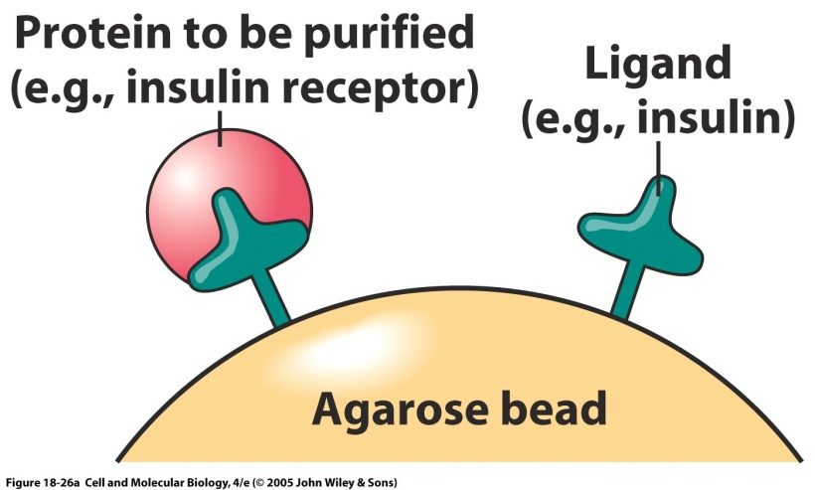
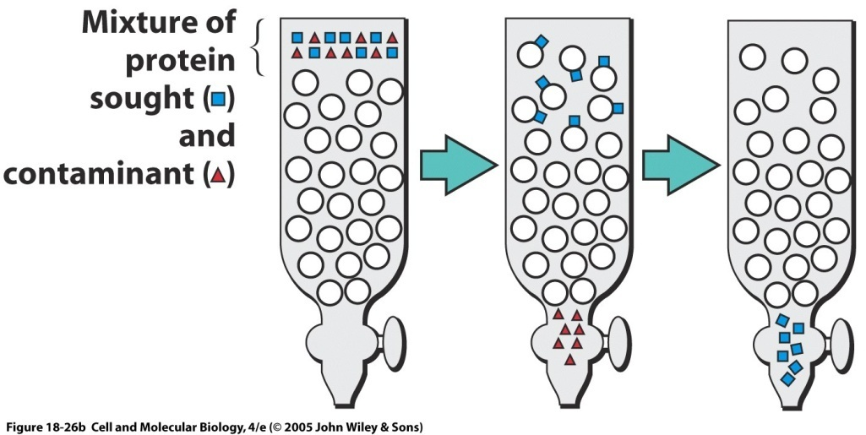
Affinity chromatography
Useful if you have a known or desired target or ligand
Only proteins that bind to the target will remain in the column
Can dissociate bound protein by changing pH
Depending on initial protein mixture, may get closely related proteins or multiple bound proteins

Slide 9
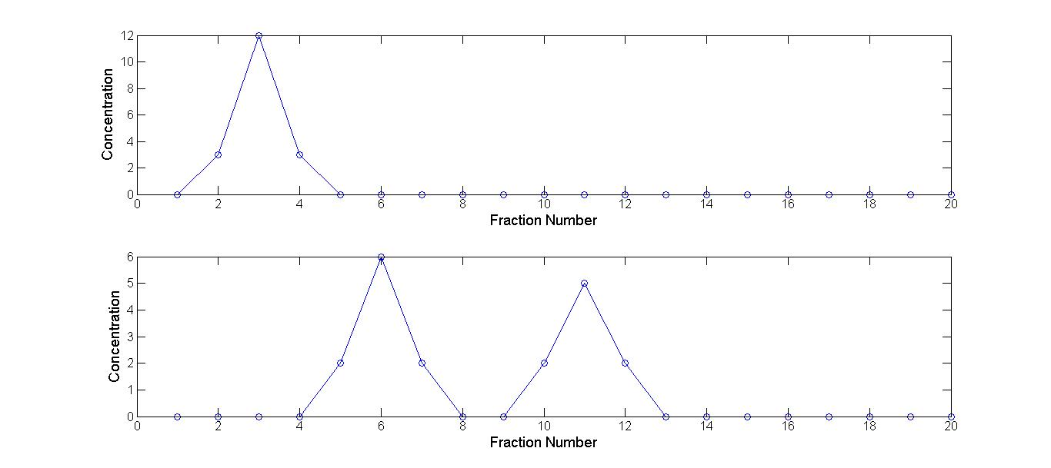
Clicker question: If the top and bottom show two runs of ion-exchange chromatography where one or more variables were changed, which variable(s) were changed?
The column was shortened
The cysteine disulfide bonds were broken
The pH of the column solvent was changed
B and C
A and C
Notes:
Answer is C.

Slide 10
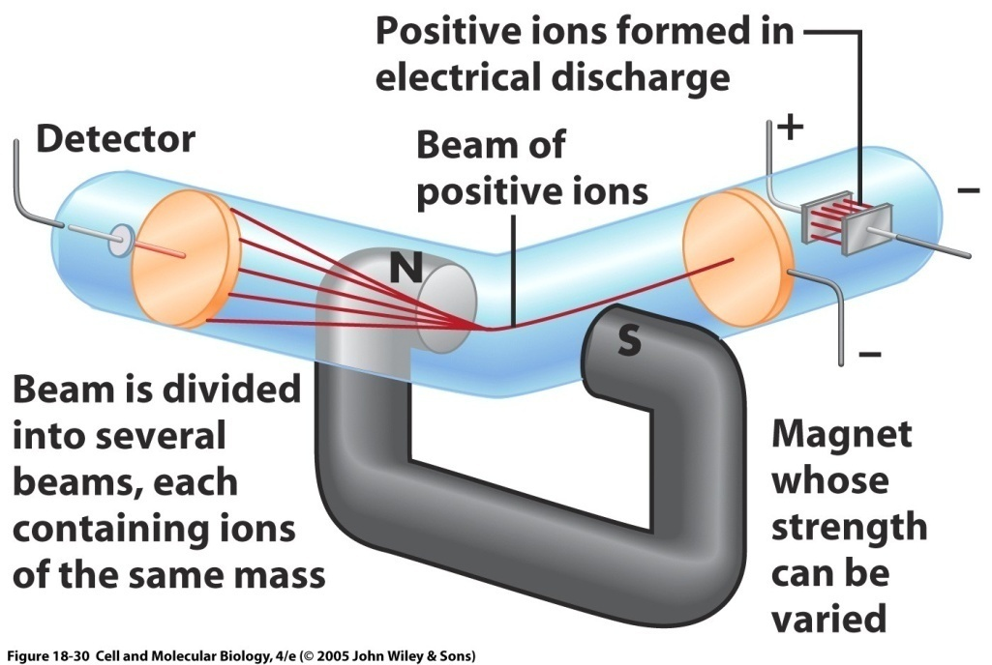
Mass spectrometry 2
For tandem MS, there would be a filter rather than a detector, where only certain m/z ratios would be allowed to pass to a second MS
Vaporized peptide fragments pass through a magnetic field that separates them by their mass/charge ratio (m/z ratio).
The ions are accelerated and then deflected by the magnet according to their mass. Lighter fragments are deflected more.
The ion flux (number of ions/unit time) is detected at the detector for each mass, separated by time of arrival and position on detector.
Notes:
10

Slide 11
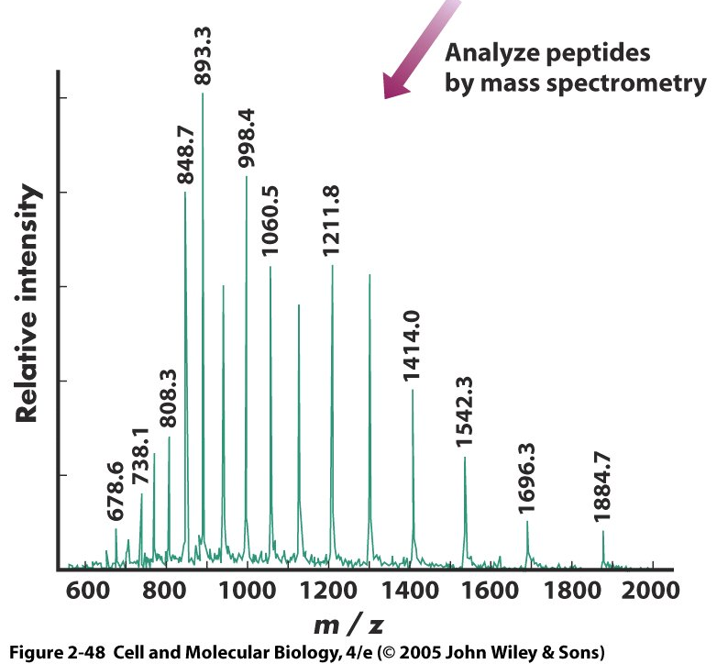
Mass spectrometry 3
Each protein will have a signature in the mass spectrometer
Can be compared with a database
Or some fragments can undergo another round of mass spectrometry at a finer level of detail to reveal the amino acid sequence, which is called tandem mass spectrometry.
In this case, fragments with a selected mass pass through a second mass spectrometer
Notes:
11

Slide 12
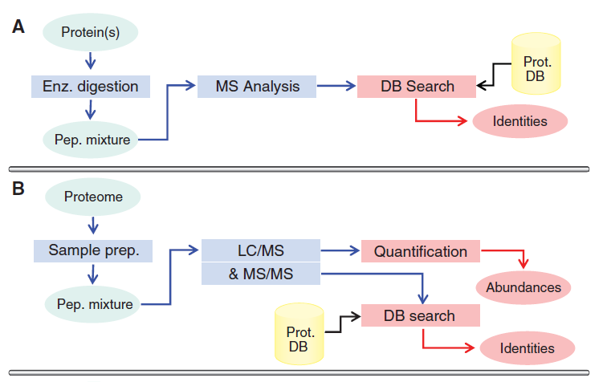
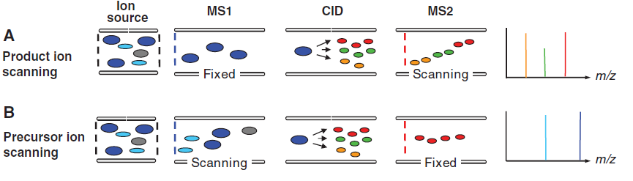
Two common types of tandem mass spectrometry and their workflow
In each, they go through two rounds of fragmentation, at the ion source or before that (not shown) and in the collision cell, where collision induced dissociation (CID) occur. They also go through two mass spectrometry chambers where fragments with specific m/z are selected.
Domon and Aebersold 2006
Notes:
For collision induced dissociation, the protein fragments are accelerated and collide into a mixture of a neutral gas (e.g. argon, N2), which produces collision energy to fragment the bonds of the proteins.

Slide 13
What if you have a mixture of unknown proteins or want to compare proteins across species or manipulations?
Modern mass spectrometry, especially tandem mass spectrometry, works quite well, but it requires more complicated analysis and can be expensive
Earlier and current methods often use another technique called…
Notes:
13

Slide 14
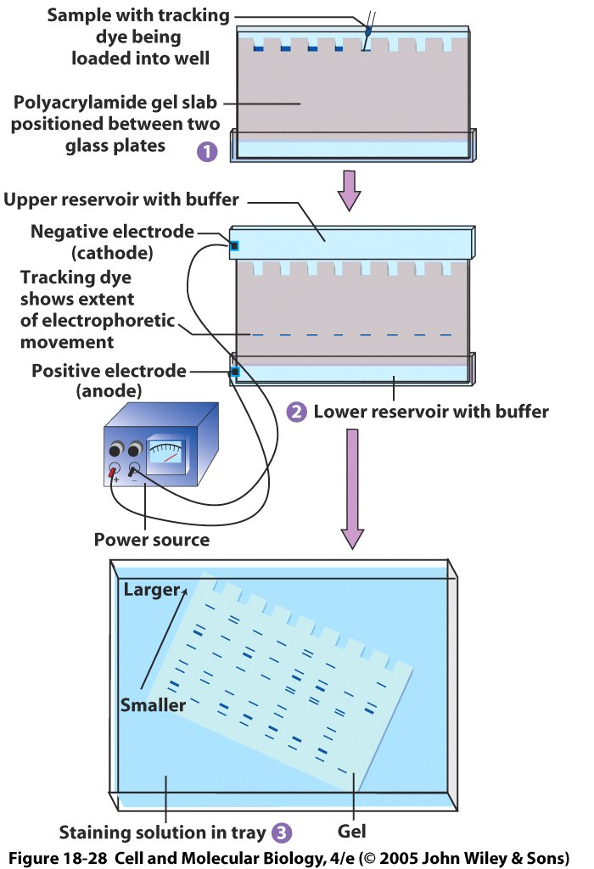
Gel electrophoresis
Can be one or two dimensional
Separate proteins by size and/or isoelectric point
Similar to chromatography in that a matrix alters movement of a protein.
Commonly use SDS-PAGE, or sodium dodecyl sulfate polyacrylamide gel electrophoresis.
Negatively charged SDS attach all over proteins and put in a voltage gradient.
Larger proteins move more slowly and remain near the top of the gel.
Example of one dimensional electrophoresis (size). Each column is a different sample.
Notes:
14
In SDS PAGE, SDS equalizes charge density of all proteins and only separator is mass

Slide 15
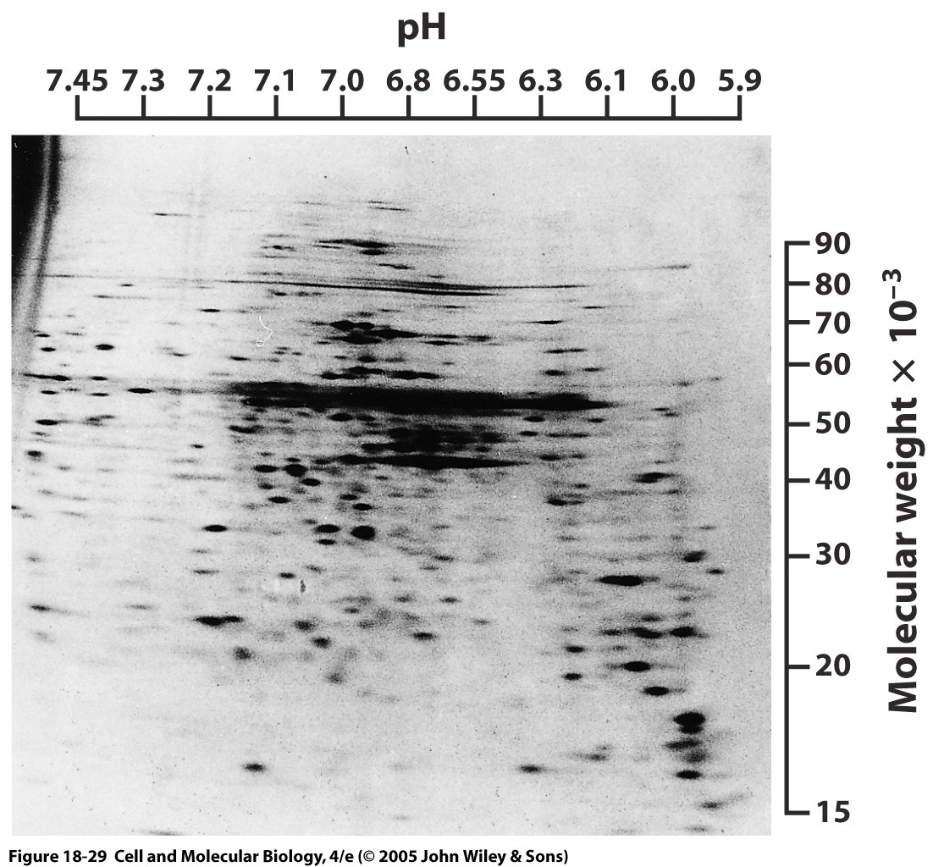
Two-dimensional gel electrophoresis
The two dimensions are typically mass and isoelectric point, the point at which the protein is neutral.
One can segregate most proteins in a cell simultaneously like this.
Notes:
15

Slide 16
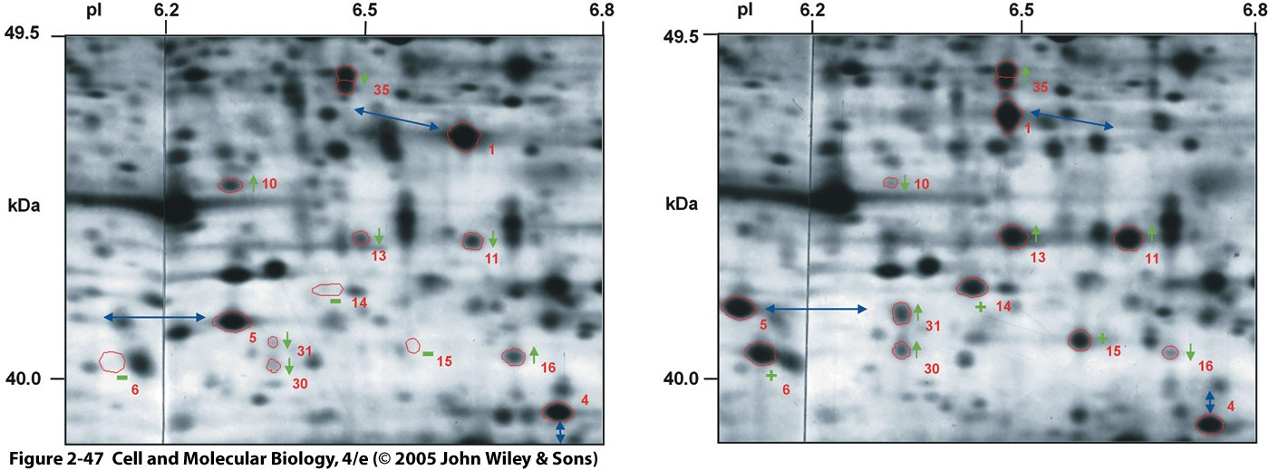
Application of two-dimensional gel electrophoresis to compare human and chimpanzee proteins
Overall pattern is very similar between human (left) or chimpanzee tissue samples from frontal cortex (right)
Circled regions highlight differences between species, either as a shift in the position on the gel or in the intensity of the spot (amount of protein)
Proteins of interest can then be studied further, sometimes by simply removing the stained portion of interest containing the protein.
Notes:
16

Slide 17
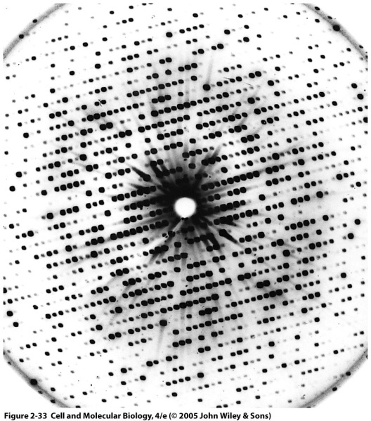
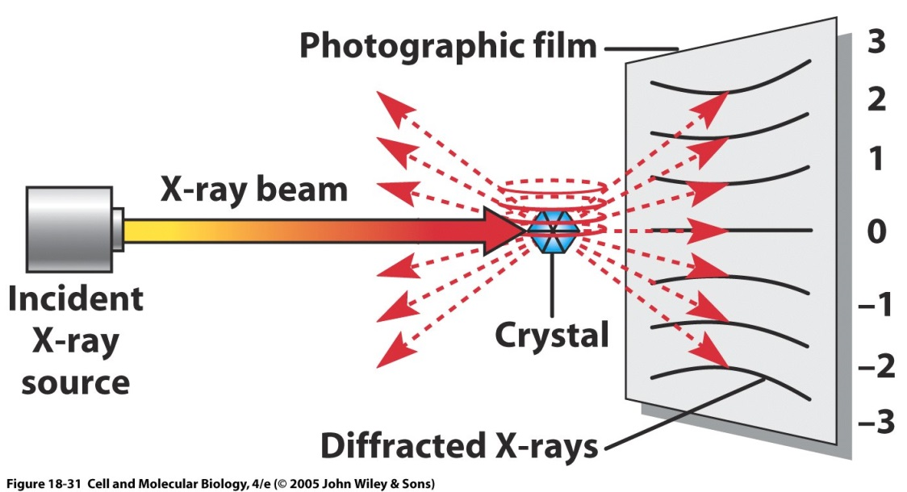
X-ray diffraction can provide the highest-resolution picture of protein tertiary crystal structure
Typical diffraction pattern
Sample must be a crystal, because need ordered repeating structure. Crystal creation lies at the science/magic interface (kidding, mostly)
A very short wavelength x-ray beam produces an interference pattern based on the positions of the atoms in the sample
The sample or beam can be moved to get the structure from all angles.
Notes:
17
Remember from physics that diffraction is the bending of a wave as it passes through an aperture or by an object
asinθ = nλ for a double slit, where a is the distance between slits and gives location of maximal interference
I. Steps in X-ray diffraction (X-ray crystallography) – must get most purified preparation of protein possible
A. Protein crystals are needed before X-ray crystallography can be used to characterize proteins
1. Crystal is composed of a regularly repeating arrangement of a unit cell (a single protein)
2. The ability to make a protein crystal is one of the best guarantees of molecular purity
B. Protein crystal, once formed, is bombarded with a fine X-ray beam of monochromatic wavelength
1. Radiation that is scattered (diffracted) by electrons of protein's atoms strikes an electron-sensitive detector placed behind the crystal
2. Diffraction pattern produced by the crystal is determined by the structure within protein; atoms in the crystal are in a repeating pattern,
3. The large number of molecules in crystal reinforces reflections —> it behaves like one large molecule
II. Data obtained
A. Reflection positions & intensities on plates are related mathematically to protein electron densities, since it is the electrons of the atoms that produced them; reflections appear as spots on plates
1. Because of the way in which the crystal is bombarded, each plate represents a slice of molecule; one must analyze many plates to get a single diffraction pattern
2. Resolution obtained by X-ray diffraction depends on the number of spots that are analyzed
B. Spots closer to pattern center result from X-rays scattered at smaller angles from crystal; provide information about grosser aspects of protein (long spacings within molecule)
C. Spots closer to periphery of photograph contain information about closely spaced aspects of molecules within crystal —> resolution depends on the number of spots analyzed
III. Example: myoglobin, first protein whose structure was determined by X-ray diffraction; analyzed successively at resolutions of 6, 2 & 1.4 Å, with years elapsing between each completed determination
A. Since covalent bonds are 1 - 1.5 Å in length & noncovalent bonds are between 2.8 Å & 4Å in length, information gathered on protein depends on resolution achieved
B. In myoglobin, at 6 Å resolution —> showed manner in which myoglobin polypeptide chain is folded & the location of the heme moiety, but it is not sufficient to show structure within chain
1. At 2 Å resolution —> groups of atoms could be separated from one another
2. At 1.4 Å resolution —> positions of individual atoms were determined
C. By the end of 2002, the structure of >250 proteins had been determined at atomic resolution (>1.2 Å) & a handful as low as 0.8 Å
http://www.youtube.com/watch?v=ejqleVj4plE

Slide 18
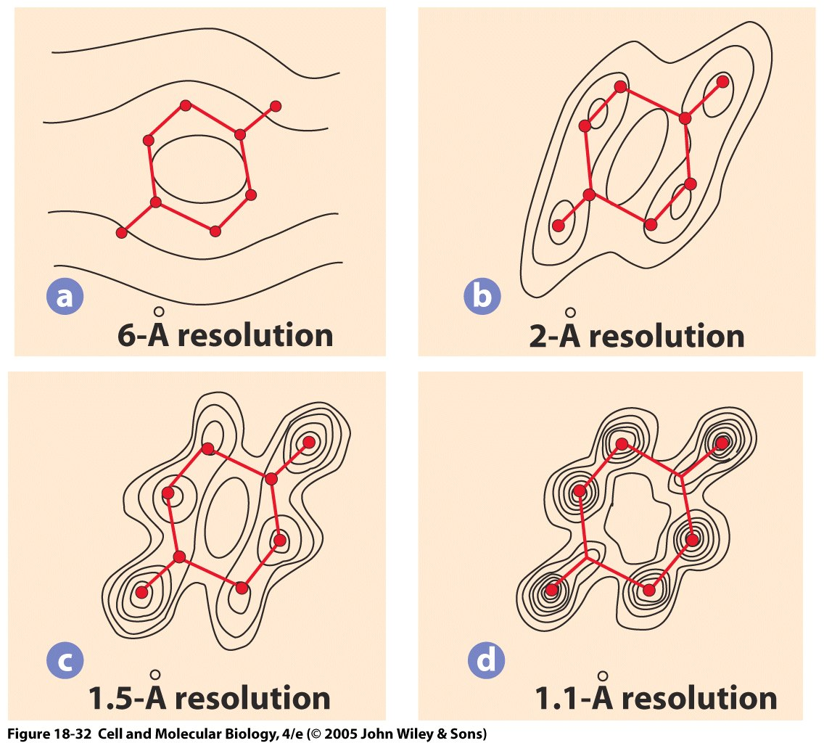
X-ray diffraction can give extremely precise structural information
Down to ≤1 angstrom, where individual electron density patterns can be detected
Computational power for reconstructing diffraction patterns enables tertiary structure calculations within a day
Difficult for membrane proteins, because structure often changes if removed from membrane
Notes:
18

Slide 19
Minor et al. 2007

Slide 20
Zika virus was reconstructed at Purdue by cryo-electron microscopy (cryo-EM)!
Sirohi et al. 2016
Notes:
Fig. 1. The cryo-EM structure of Zika virus at 3.8Å. (A) A representative cryo-EM image of frozen, hydrated ZIKV showing the distribution of virion phenotypes. Smooth, mature virus particles are identified by a surrounding black box. A partially mature virus particle is identified by the yellow arrow. (B) A surface-shaded depth cued representation of ZIKV viewed down the icosahedral two-fold axis. The asymmetric unit is identified by the black triangle. (C) A cross-section of ZIKV showing the radial density distribution. Panels B and C are color-coded based on the following radii: up to 130Å, blue; 131Å to 150Å, cyan; 151Å to 190Å, green; 191Å to 230Å, yellow, from 231Å, red. The region shown in blue fails to follow icosahedral symmetry and therefore its density is uninterruptable as is the case with other flaviviruses. (D) A plot of the Fourier shell coefficient (FSC). Based on the 0.143 criterion for the gold standard comparison of two independent data sets, the resolution of the reconstruction is 3.8Å. The x axis shows 1/resolution in Å−1; the y axis shows the FSC value. (E) The Cα backbone of the E and M proteins in the icosahedral ZIKV particle (same orientation as in Panel B above) showing the herringbone organization. The color code fits the standard designation of E protein domains I (red), domain II (yellow) and domain III (blue). (F) Representative cryo-EM electron densities of several amino acids of the E protein.

Slide 21
Two of the main subunits of the Zika viral envelope
Notes:
Fig. 2. The structures of Zika virus E and M proteins. (A) The E protein dimer is shown in ribbon form viewed down the two-fold axis. The color code fits the standard designation of E protein domains I (red), domain II (yellow) and domain III (blue). The underlying stem and transmembrane residues are shown (pink). The fusion loop (green; fig. S1), Asn154 glycan, and the variable loop surrounding the Asn154 glycan (residues 145-160, cyan) are highlighted. (B) Side view of the E-M dimer showing the three E ectodomains as well as the E stem/transmembrane domains (pink) and the M loop and stem/transmembrane domains (light blue). The E and M transmembrane domains are found within the lipid bilayer (Fig. 1C). All residues of M (1-75) and all but three residues of E (1- 501) were identified in the density. The Asn154 glycan from one monomer is labeled and can be seen projecting from the surface.

Slide 22
Flowchart of sample preparation for cryo-EM
From Cheng et al. 2015. Cell 161, April 23, 2015
Notes:
Figure 1. The Steps Involved in Structure Determination by Single-Particle Cryo-EMA single-particle project should start with a characterization of the specimen in negative stain (left arm of the workﬂow). Only once the EM images, or potentially 2D class averages, are satisfactory, i.e., the particles are mono-disperse and show little aggregation and a manageable degree of heteroge-neity (‘‘low-resolution’’ sample reﬁnement), is the sample ready for analysis by cryo-EM (right arm of the workﬂow). The images, 2D class averages and 3D maps obtained with vitriﬁed specimens may indicate that the sample requires further improvement to reach near-atomic resolution (‘‘high-resolution’’ sam-ple reﬁnement).

Slide 23
Cryo-EM can show detailed bacteriophage structure, resolution proportional to acceleration of electron beam
Jiang et al. 2006, Wen Jiang is in Bio. Dept, Purdue University
Notes:
23
23
Cryo-EM = cryo-electron microscopy
Figure 1 | Structure of epsilon15
bacteriophage. a, 200-kV CCD
image of epsilon15 particles
embedded in vitreous ice. b, Surface
rendering of the 20A ° resolution
three-dimensional map of entire
epsilon15 bacteriophage
reconstructed without symmetry
imposition. The capsid (dark green)
exhibits good icosahedral symmetry
as indicated by the icosahedral
lattice (grey). c, d, The structural
components of epsilon15
bacteriophage are annotated in the
central section density (c) and the
cut-away surface view (d) of the
three-dimensional density map.
Each of the structural components
is coloured differently and the same
colour scheme is used in Figs 1–3.
e, A slightly tilted view of the
coaxially packed dsDNA genome.
Only portions of the first and
second layers of dsDNA are shown
so that the three outermost layers
can be viewed. Colour gradient (light
blue to darker blue) is used in d and
e to indicate the likely packaging
order of the dsDNA starting from
the outer layer towards inner layers
and ending as the central straight
segment of terminus.

Slide 24
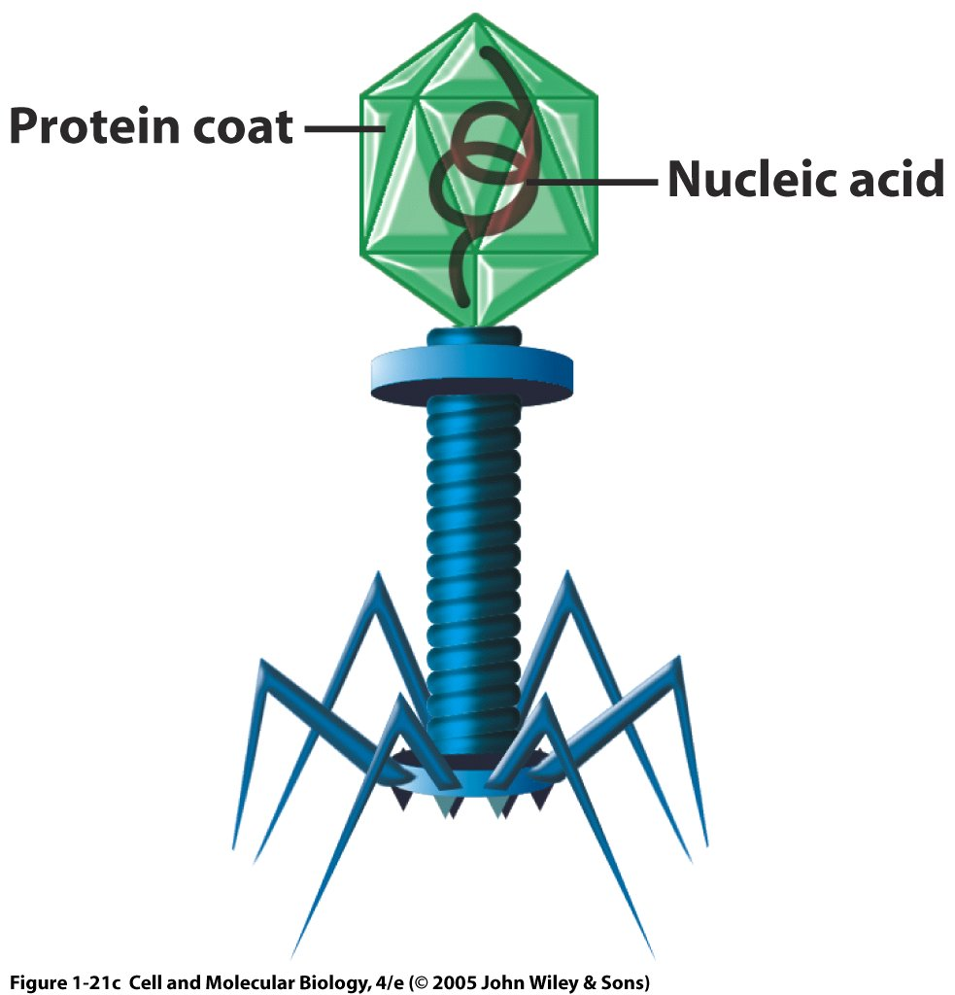
Bacteriophages are complex viruses that infect bacteria.
They consist of:
A polyhedral head that contains DNA
A stalk through which DNA is injected
Tail fibers to attach to bacteria
Notes:
24
24
Bacterial viruses (bacteriophages) are among most complex – T bacteriophages polyhedral head (contains DNA), cylindrical stalk (injects DNA into bacterium) & tail fibers (attach to bacteria)
1. Used in key experiments that revealed genetic material structure & properties

Slide 25
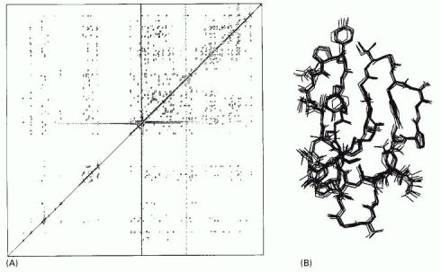
Nuclear magnetic resonance (NMR) spectroscopy
Example protein: cellulase. Left: Two-D NMR spectrum. Right: Reconstructed structures satisfying constraints.
Chemical Shift RF-B
Alberts et al., Molecular Biology of the Cell
Chemical Shift- RF-A
NMR can bypass the main constraint of x-ray crystallograpy because it requires protein in a solution, rather than a crystal.
Measures the emitted radiation from hydrogen atoms that have been forced to align by a strong magnetic field.
Can monitor changes in structure with binding, etc.
Only works for molecules <= 40-50 kD (relatively small)
Notes:
25
http://www.cem.msu.edu/~reusch/VirtualText/Spectrpy/nmr/nmr1.html
http://www2.chemistry.msu.edu/faculty/reusch/VirtTxtJml/Spectrpy/nmr/nmr1.htm
may operate by sweeping the magnetic field. Using this terminology, we would find that at 2.34 T the proton signals shown above extend over a 4,200 Hz range (for a 100 MHz rf frequency, 42 ppm is 4,200 Hz). Most organic compounds exhibit proton resonances that fall within a 12 ppm range (the shaded area), and it is therefore necessary to use very sensitive and precise spectrometers to resolve structurally distinct sets of hydrogen atoms within this narrow range. In this respect it might be noted that the detection of a part-per-million difference is equivalent to detecting a 1 millimeter difference in distances of 1 kilometer.
Nice NMR tutorials
Unlike x-ray crystallography, NMR does not depend on having a crystalline sample; it simply requires a small volume of concentrated protein solution that is placed in a strong magnetic field.
Certain atomic nuclei, and in particular those of hydrogen, have a magnetic moment or spin: that is, they have an intrinsic magnetization, like a bar magnet. The spin aligns along the strong magnetic field, but it can be changed to a misaligned, excited state in response to applied radiofrequency (RF) pulses of electromagnetic radiation. When the excited hydrogen nuclei return to their aligned state, they emit RF radiation, which can be measured and displayed as a spectrum.
Chemical shift is the change in resonant frequency due to the local environment. Small changes in frequency 100 Hz out of 100-900 MHz. In 2-D NMR shown, experiment is a series of RF pulses whose characteristics are highly controlled. Off-diagonal peaks are coupled hydrogens. Often pulse interval varied.
For technical reasons the structure of small proteins of about 20,000 daltons or less can readily be determined by NMR spectroscopy. Resolution is lost as the size of a macromolecule increases. But recent technical advances have now pushed the limit to about 100,000 daltons, thereby making the majority of proteins accessible for structural analysis by NMR.
The NMR method is especially useful when a protein of interest has resisted attempts at crystallization, a common problem for many membrane proteins. Because NMR studies are performed in solution, this method also offers a convenient means of monitoring changes in protein structure, for example during protein folding or when a substrate binds to the protein. NMR is also used widely to investigate molecules other than proteins and is valuable, for example, as a method to determine the three-dimensional structures of RNA molecules and the complex carbohydrate side chains of glycoproteins.
Figure 8-46. NMR spectroscopy. (A) An example of the data from an NMR machine. This two-dimensional NMR spectrum is derived from the C-terminal domain of the enzyme cellulase. The spots represent interactions between hydrogen atoms that are near neighbors in the protein and hence reflects the distance that separates them. Complex computing methods, in conjunction with the known amino acid sequence, enable possible compatible structures to be derived. In (B) 10 structures, which all satisfy the distance constraints equally well, are shown superimposed on one another, giving a good indication of the probable three-dimensional structure. (Courtesy of P. Kraulis.)

Slide 26
Additional links for NMR principles
http://chem.ch.huji.ac.il/nmr/whatisnmr/whatisnmr.html
https://www2.chemistry.msu.edu/faculty/reusch/virttxtjml/spectrpy/nmr/nmr1.htm

Slide 27
Now we have been able to identify the sequence and structure of one protein. Can we find out anything about who the protein interacts with?
Notes:
27

Slide 28
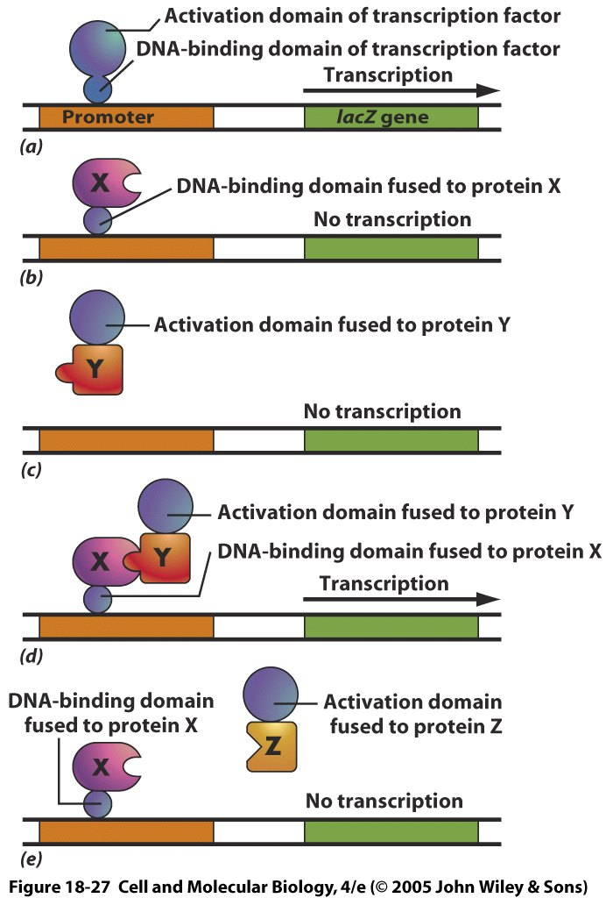
The yeast two-hybrid system detects interactions
(Top) Normal case. Activation domain and DNA binding domain needed for transcription of lacZ (beta-galactosidase reporter gene)
If only DNA binding domain fused to protein X, no transcription.
A battery of potential protein Ys are bound to an activation domain
Only when an interaction occurs with protein X (shown in d but not e) will transcription occur.
Notes:
28
The fused proteins must be minimally altered to still have interactions, which is why e is necessary
The yeast two-hybrid system for detecting protein-protein interactions. The target protein is fused to a DNA-binding domain that localizes it to the regulatory region of a reporter gene as “bait.” When this target protein binds to another specially designed protein in the cell nucleus (“prey”), their interaction brings together two halves of a transcriptional activator, which then switches on the expression of the reporter gene. The reporter gene is often one that will permit growth on a selective medium. Bait and prey fusion proteins are generated by standard recombinant DNA techniques. In most cases, a single bait protein is used to fish for interacting partners among a large collection of prey proteins produced by ligating DNA encoding the activation domain of a transcriptional activator to a large mixture of DNA fragments from a cDNA library.

Slide 29
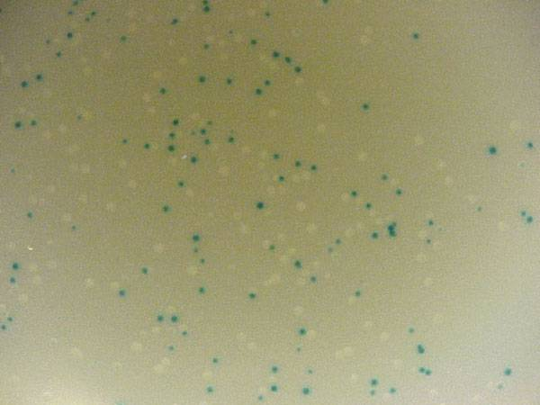
Example of lacZ stained cells
http://www.bio.davidson.edu/courses/genomics/method/reporters.html
Notes:
29
Perhaps the most common use of lacZ is for blue/white selection when cloning a DNA insert into a plasmid (figure 3). If the plasmid contains a version of lacZ with a polylinker, then you can determine visually whether you have cloned the insert or not. If the insert is ligated into the polylinker, then the lacZ gene will be disrupted and the colony will be white. If no insert is incorporated into the plasmid, the lacZ gene is left intact and it is able to produce β-galactosidase and the colon will turn blue. Notice in how some colonies are dark blue, some are light blue and others are pure white. You can tell that this system is not 100% error free. In fact, if the insert is a multiple of three base pairs in size, it might be possible to create an inframe insertion and still produce blue colonies. Nevertheless, blue/white selection is a helpful way to visually screen the success of your ligation and transformation before isolating plasmid DNA.

Slide 30
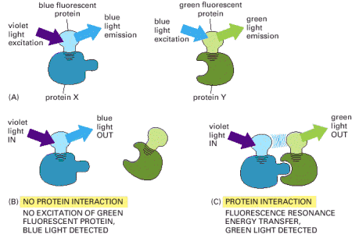
Fluorescence resonance energy transfer: Protein interactions? No worries, just FRET
Often used to measure changes in interactions between proteins or within a protein due to conformational changes
The unbound protein X that has been labeled with fluorescent protein will emit blue photons when excited by violet light using BFP as the fluorophore.
Binding of the protein Y to X changes the conformation and through FRET, changes the emitted light to green using GFP as the fluorophore.
Notes:
30
GFP, and its derivatives of different colors, can also be used to monitor protein-protein interactions. In this application, two proteins of interest are each labeled with a different fluorochrome, such that the emission spectrum of one fluorochrome overlaps the absorption spectrum of the second fluorochrome. If the two proteins—and their attached fluorochromes—come very close to each other (within about 1–10 nm), the energy of the absorbed light will be transferred from one fluorochrome to the other. The energy transfer, called fluorescence resonance energy transfer (FRET), is determined by illuminating the first fluorochrome and measuring emission from the second (Figure 8-49). By using two different spectral variants of GFP as the fluorochromes in such studies, one can monitor the interaction of any two protein molecules inside a living cell.
Figure 8-49. Fluorescence resonance energy transfer (FRET). To determine whether (and when) two proteins interact inside the cell, the proteins are first produced as fusion proteins attached to different variants of GFP. (A) In this example, protein X is coupled to a blue fluorescent protein, which is excited by violet light (370–440 nm) and emits blue light (440–480 nm); protein Y is coupled to a green fluorescent protein, which is excited by blue light and emits green light (510 nm). (B) If protein X and Y do not interact, illuminating the sample with violet light yields fluorescence from the blue fluorescent protein only. (C) When protein X and protein Y interact, FRET can now occur. Illuminating the sample with violet light excites the blue fluorescent protein, whose emission in turn excites the green fluorescent protein, resulting in an emission of green light. The fluorochromes must be quite close together—within about 1–10 nm of one another—for FRET to occur. Because not every molecule of protein X and protein Y is bound at all times, some blue light may still be detected. But as the two proteins begin to interact, emission from the donor GFP falls as the emission from the acceptor GFP rises.
See also http://www.olympusfluoview.com/applications/fretintro.html

Slide 31
Clicker Question
How would you identify a mystery protein if it was in a mix of other proteins and was soluble in water?
Crystallize the protein and use NMR spectroscopy
Use chromatography to separate from proteins of other sizes, then use x-ray diffraction if the molecule can be crystallized (or NMR spectroscopy if it can not)
Use a yeast two-hybrid system to quantify fluorescence resonance energy transfer
Use mass spectroscopy to pass the liquid mixture through a magnetic field that separates fragments by their mass/charge ratio (m/z ratio)
Notes:
31
Answer is B

Slide 32
How would you ID a mystery protein if:
You had a protein crystal
X-ray diffraction
You had to extract it from a mix of proteins
Chromatography
It had to be in solution
NMR spectroscopy
You wanted to find proteins that interacted with a specific protein of interest
Yeast two-hybrid system
FRET
Notes:
32

Slide 33
Summary
Protein interactions are specific
Protein identification
Chromatography
Mass spectroscopy
Gel electrophoresis
X-ray diffraction
Electron microscopy
Protein function
Yeast two hybrid system
Fluorescence energy transfer

Slide 34
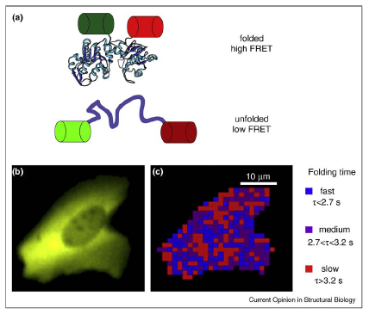
Protein folding can also be monitored using FRET
Gershenson et al. 2011
Notes:
Monitoring protein folding kinetics in a living cell using fast relaxation imaging (FReI) [68]. (a) The folding sensor was created by sandwiching a
temperature-sensitive POI (here, PGK) between two fluorescent proteins, GFP and mCherry, allowing folding to be monitored by FRET. (b) Image of
the fluorescence arising from the expression of the fusion protein in a human cell. (c) Map of the refolding dynamics of the fusion protein in the cell
shown in (b). The time dependence of the FRET signal following a temperature jump is spatially mapped. (b) and (c) are courtesy of M. Gruebele.

Slide 35
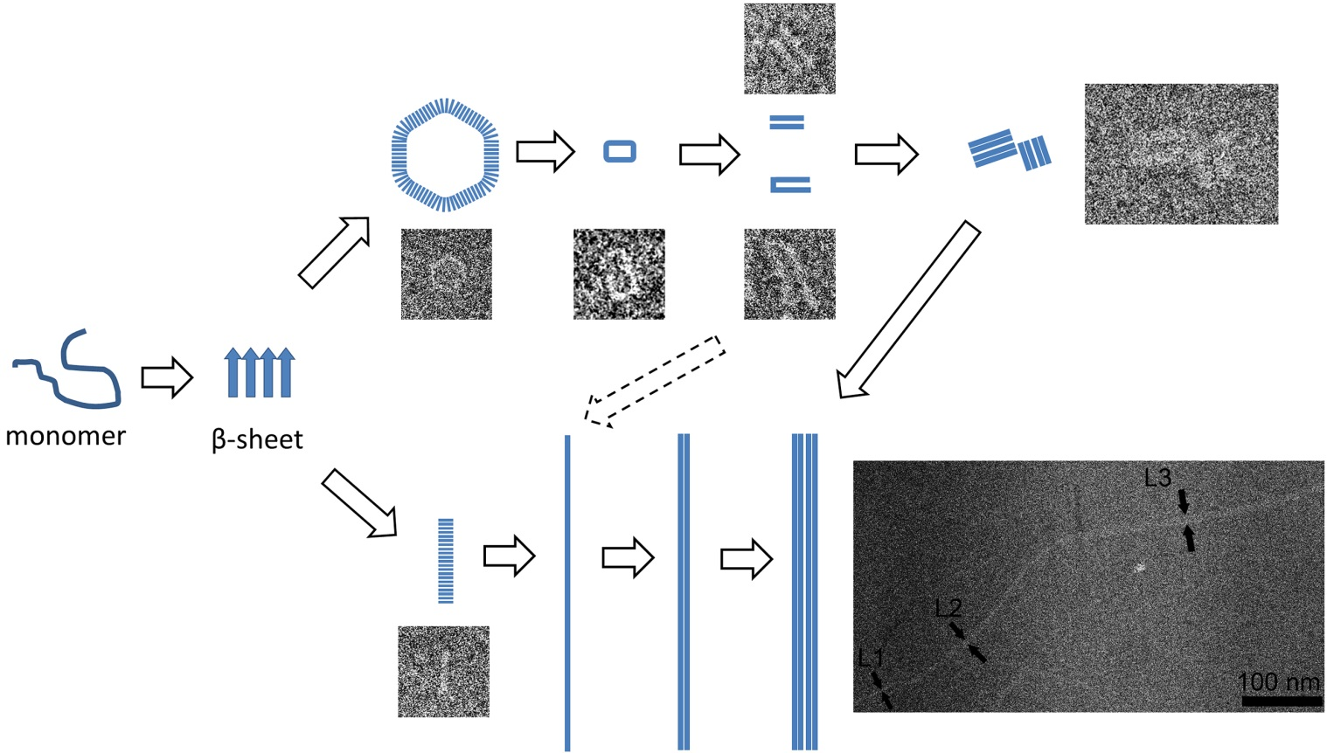
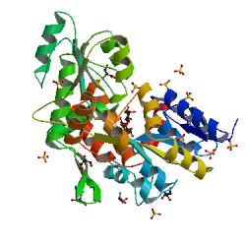
Recent protein folding work from Purdue! When protein folding goes rogue
http://www.purdue.edu/newsroom/releases/2013/Q3/research-yields-first-detailed-view-of-morphing-parkinsons-protein.html
Native alpha-synuclein structure
Aggregated protein fibril that cause neuron cell death in Parkinson’s and Alzheimer’s
Zhang et al. 2013

Slide 36
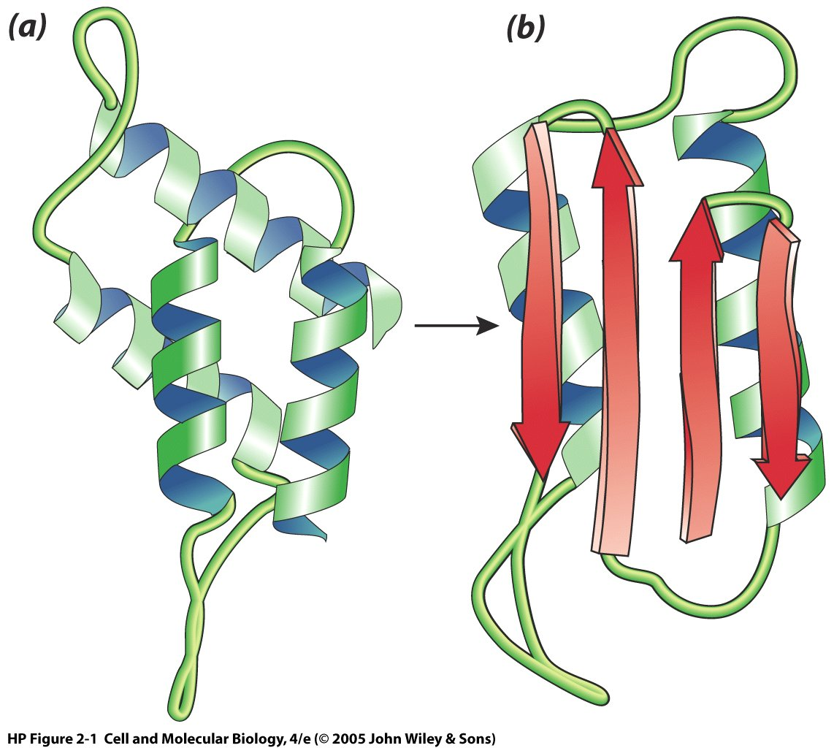
Creutzfeldt-Jakob disease (mad-cow) results from a folding variant of the same amino acid sequence
Left: Normal, digestible Right: Pathological, forms clumps
Addition of mad-cow version can convert normal prion protein. It is very unusual for a protein by itself to be pathogenic. All known prion diseases only affect neural tissue.
Notes:
36
PrPc = normal but function unknown, but can be digested by proteases, mostly alpha helix
PrPc is expressed in neurons throughout brain and appears to be involved in proper synaptic function
PrPSc = abnormal pathologic version that forms insoluble aggregates. Beta sheet core
In vitro addition of PrpSc can alter conformation of PrPc to PrPSc

Slide 37
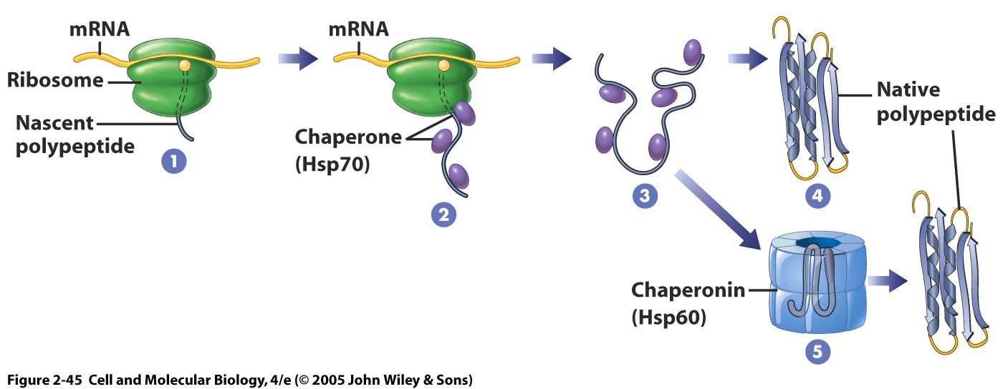
With a little help from your friends: molecular chaperones aid protein folding
Self-assembly does not work for all proteins (works for about 70% of eukaryotic proteins and 70-80% prokaryotic proteins)
Molecular chaperones assist folding and shield interactions with other proteins during folding
Chaperones typically bind to short, hydrophobic sequences that are exposed in newly formed (nascent) polypeptide
Unlike most proteins, chaperones are nonspecific with many binding targets to a hydrophobic sequence. 10-15% of proteins in a cell can use the same type of chaperone.
Notes:
37
If radioactive amino acids are added to cells for a brief period, the newly synthesized proteins can be followed as they mature into their final functional form. It is this type of experiment that shows that the hsp70 proteins act first, beginning when a protein is still being synthesized on a ribosome, and that the hsp60-like proteins are called into play only later to help in folding completed proteins. However, the same experiments reveal that only a subset of the newly synthesized proteins becomes involved: perhaps 20% of all bacterial proteins with the hsp70 and 10% with the hsp60-like molecular chaperones. How are these proteins selected for this ATP-catalyzed refolding?
The hsp60-like and hsp70 proteins each work with their own small set of associated proteins when they help other proteins to fold. They share an affinity for the exposed hydrophobic patches on incompletely folded proteins, and they hydrolyze ATP, often binding and releasing their protein with each cycle of ATP hydrolysis. In other respects, the two types of hsp proteins function differently. The hsp70 machinery acts early in the life of many proteins, binding to a string of about seven hydrophobic amino acids before the protein leaves the ribosome (Figure 6-83). In contrast, hsp60-like proteins form a large barrel-shaped structure that acts later in a protein's life, after it has been fully synthesized. This type of chaperone forms an “isolation chamber” into which misfolded proteins are fed, preventing their aggregation and providing them with a favorable environment in which to attempt to refold (Figure 6-84).

Slide 38
Molecular chaperones are “helper proteins” to prevent nonselective interactions during protein folding that lead to misfolding.
Hsp 70 family bind emerging proteins and prevent inappropriate interactions.
Chaperonins allow large new proteins to assemble without interference from other macromolecules.

Slide 39
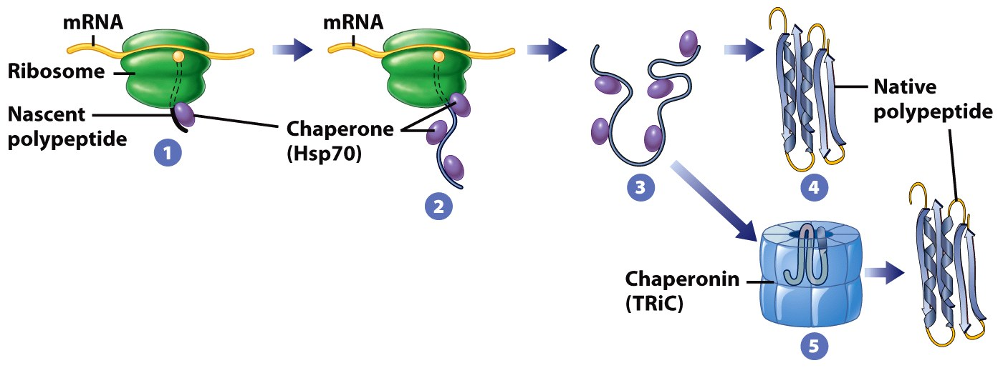
The role of molecular chaperones in encouraging protein folding

Slide 40
Completed amino acid sequences are either released by the chaperone or brought to a new chaperone
Many proteins, once assisted, can fold into their native shape
Large proteins can be transferred to a chaperonin (5)
Chaperonins are cylindrical and act as protein isolation chambers to shield protein during folding.
Notes:
40
Molecular chaperones - help proteins to fold into final 3D conformation; nonspecific (one can work on many proteins);

Slide 41
The first discovered chaperone was a heat shock protein, hsp70
Discovered in Drosophila (fruit flies) when temperature raised from 25° C to 32° C
Found that occurred at normal temperatures in smaller concentrations
Called hsp70 because 70 kilodaltons in molecular mass (1 H atom has a mass of 1 dalton)
Hsp60 chaperones found throughout organisms, from bacteria (GroEL) to plants BiP (Rubisco binding protein)
Notes:
41
easure of molecular weight or mass. One hydrogen atom has mass of 1 Da, so 1 Da = 1 g/mol. Proteins and other macromolecule molecular weights are usually measured in kDa or kD (kilodaltons) - 1000 Da. Average amino acid = 110 Da.

Slide 42
Clicker question: Why would you need more chaperones to help with protein folding at higher temperatures?
More proteins are produced at higher temperatures
There are relatively more hydrophobic interactions at higher temperatures
Higher temperatures make free energy and conformational fluctuations larger
Higher temperatures permit only stable structures
Notes:
Answer is C

Slide 43
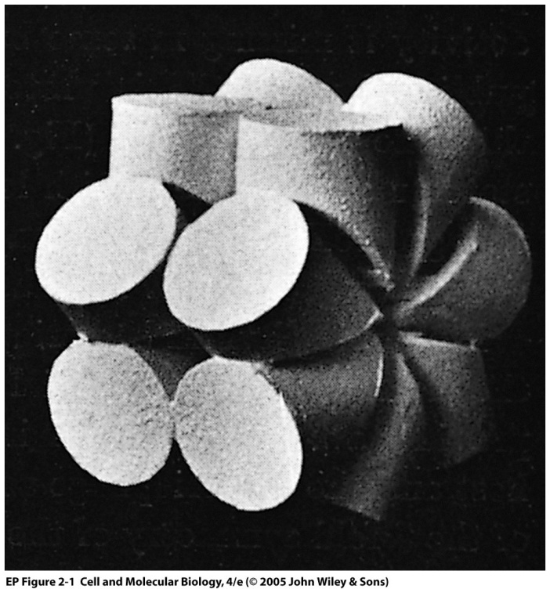
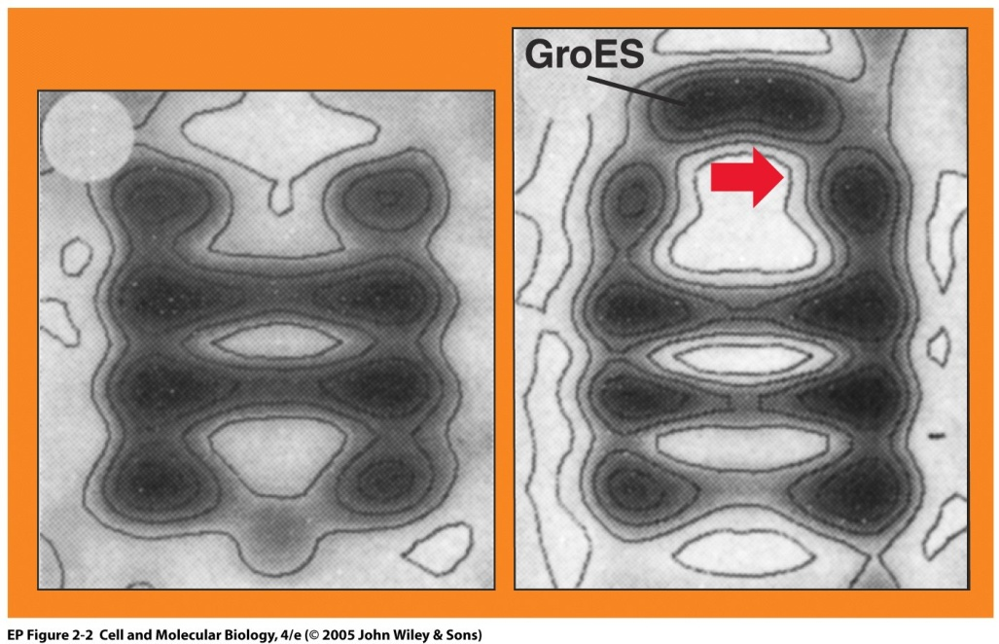
Hsp60 chaperones are another class of large chaperone proteins and are found throughout organisms, from bacteria (GroEL) to plants (BiP)
Left: GroEL reconstructed from electron microscope (EM) images
Middle: GroEL reconstructed from cryo-EM (rotated 90 degrees compared to left figure)
Right: GroES forms a cap on GroEL and forms a large cavity in which proteins can fold.
Binding GroES also changes some residues in cavity from nonpolar to polar
Notes:
43
Two 7 subunit circles form a cylindrical cavity in GroEL. GroES is the cap on the dome

Slide 44
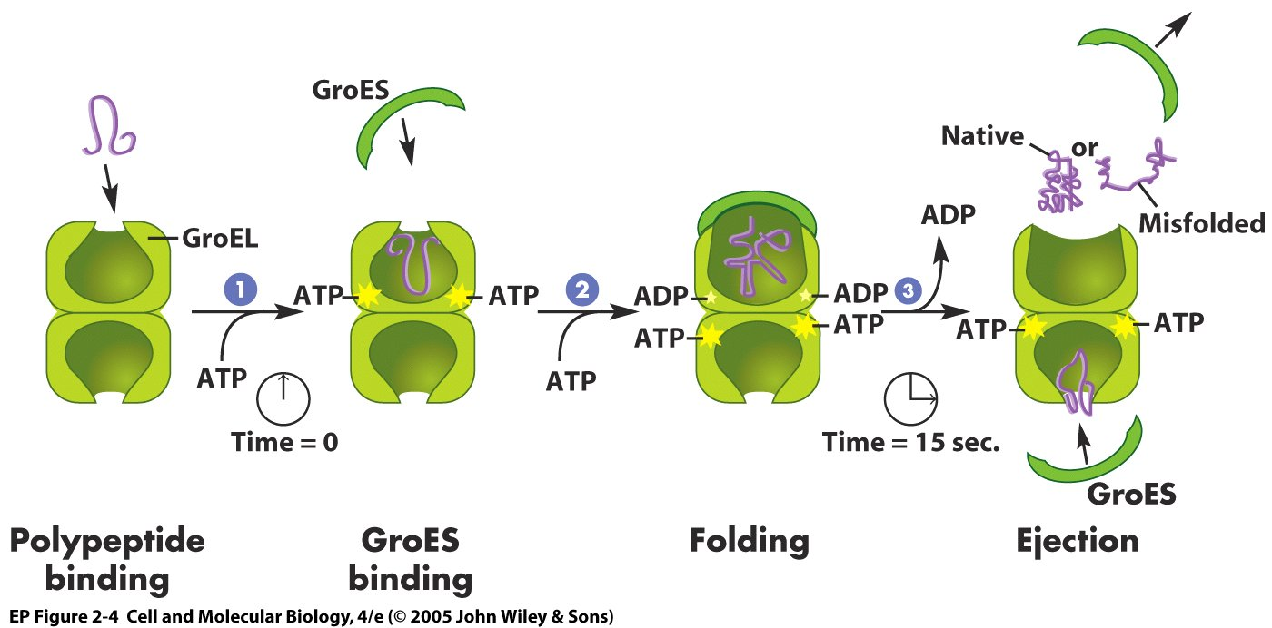
Steps in GroEL/GroES chaperoning of protein folding
Protein enters and binds to hydrophobic proteins in GroEL.
Binding of ATP allow binding of GroES, which increases size of chamber and dissociates protein from GroEL
After 10-15 seconds (eons in molecular time), GroES dissociates from GroEL, and the protein is ejected.
A misfolded protein may undergo the cycle again
Notes:
44

Slide 45
Chaperones reduce the probability of forming partially folded states or amorphous aggregates
Hartl et al. 2011

Slide 46
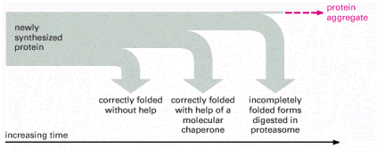
Paths and time courses of protein folding
If needed, chaperones assist protein folding.
If still detect misfolding, the misfolded protein is digested
This quality control is to prevent dysfunction and aggregation
Alberts et al., Molecular Biology of the Cell
Notes:
46
Figure 6-85. The cellular mechanisms that monitor protein quality after protein synthesis. As indicated, a newly synthesized protein sometimes folds correctly and assembles with its partners on its own, in which case it is left alone. Incompletely folded proteins are helped to refold by molecular chaparones: first by a family of hsp70 proteins, and if this fails, then by hsp60-like proteins. In both cases the client proteins are recognized by an abnormally exposed patch of hydrophobic amino acids on their surface. These processes compete with a different system that recognizes an abnormally exposed patch and transfers the protein that contains it to a proteasome for complete destruction. The combination of all of these processes is needed to prevent massive protein aggregation in a cell, which can occur when many hydrophobic regions on proteins clump together and precipitate the entire mass out of solution.

Slide 47
Protein homeostasis (proteostasis) network
Hartl et al. 2011

Slide 48
Alzheimer’s disease (AD) involves misfolded proteins that accumulate in the brains of affected individuals.
A membrane-bound protein in brain neurons, called amyloid precursor protein (APP), is cleaved by two secretase enzymes.
In individuals genetically predisposed to AD one of the cleavage products is Aβ42, a protein that misfolds and self-associates into amyloid plaques.

Slide 49
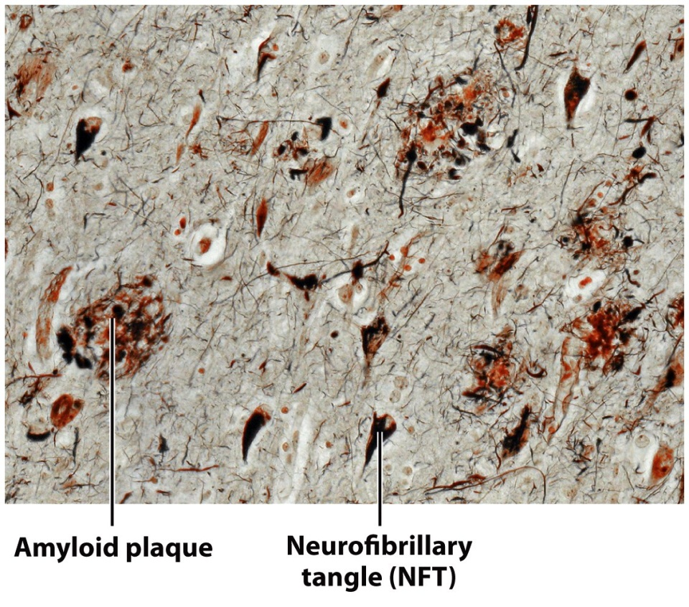
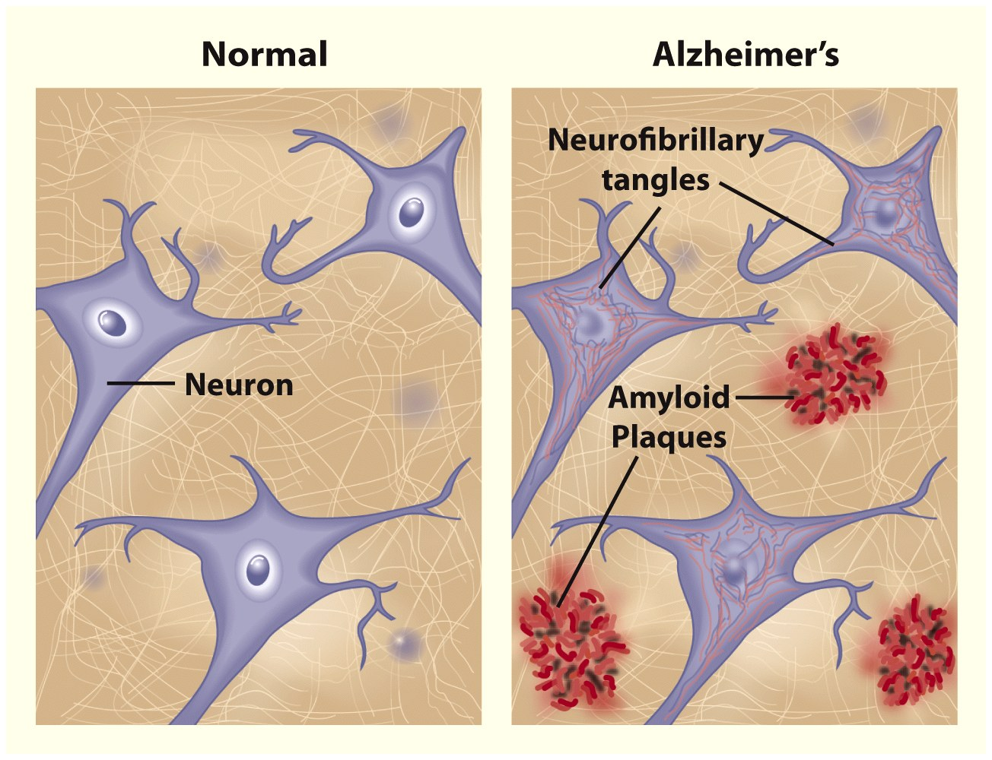
Alzheimer’s disease
End of material for Exam 1
Notes:
Tangles are also seen in chronic traumatic encephalopathy, which may be common in athletes such as football players and boxers
http://www.grantland.com/story/_/id/8218700/neuropathologist-dr-ann-mckee-accused-killing-football-be-sport-only-hope

Slide 50
End of material for exam 1

Slide 51
No amount of experimentation can ever prove me right; a single experiment can prove me wrong. Albert Einstein
It doesn't matter how beautiful your theory is, it doesn't matter how smart you are. If it doesn't agree with experiment, it's wrong. Richard P. Feynman

Slide 52
Turning observations into hypotheses
You are deep sea diving in Hawaii over winter break. 25 meters down, you notice a series of flashes of colored light. Swimming closer, it is coming from some nearby fish. You are able to catch a few (turns out that they are not endangered) and return them to your home laboratory.
Over the next few days, you notice that their flashing behavior does not occur for at least an hour after their water has been changed.
Write down a hypothesis regarding why this might be.
What additional observations or information would you want to refine this hypothesis?
Notes:
Because obviously you have a home laboratory, right?
What additional information would you need to make this hypothesis?

Slide 53
Hypotheses arise from a combination of observations, experiences, and logic
A hypothesis is a specific statement in which you propose a testable theory to explain your observations, including the important variables.
It can be narrow to explain a small group of observations (e.g. An altered shooting arm angle is causing Tim Duncan to miss free throws.) or broad to explain a large group of observations (e.g. Darwin’s theory of evolution).
The hypothesis should lead to predictions of an experimental outcome (a measured dependent variable) based on your manipulation of one or more independent variables that you have deemed important based on your observations, previous studies and logic.
It should be testable and should direct the way that you set up experiments to test the hypothesis.

Slide 54
Modern research is “hypothesis-driven”
Two reasonable links for understanding the hypothesis statement are:
http://www.experiment-resources.com/how-to-write-a-hypothesis.html
http://www.accessexcellence.org/LC/TL/filson/writhypo.php

